Slide 1
Bell Work:
x + y – z = 12
x = 3y + z
y + 2x = 9

Slide 2
From Last Time
Page 153 #19, 23, 55, 66, 67, 72
Page 179 #7, 10, 17, 23, 24, 29

Slide 3
ALGEBRA 3
Day 29

Slide 4
Objective: To solve a system with three variables with an emphasis on matrices.

Slide 5
3.5 Solving Systems with 3 Variables
You can use elimination and/or substitution to solve a system of three equations in three variables by working with the equations in pairs. (You’ll use one of the equations two times.)
Solution: (x, y, z)

Slide 6
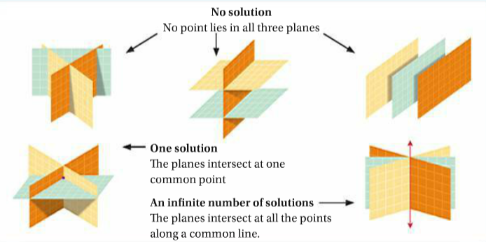
Same type of solutions as before…
-You can have No Solution (no point lies in all three planes)
-You can have One Solution (the planes intersect at one common point)
-You can have Infinitely Many Solutions (planes intersect at all points along a common line)

Slide 7

Example: Solve the system for (x,y,z)
1.)
$$x+y+z=8 → x+ y + z =8$$
$x−z=2$ $→ x+0y − z =2$
$4x−12=0$ $→ 4x+0y+0z=12$

Slide 8

Example: Solve the system for (x,y,z)
2.)
$$2x−y+z=4$$
$$x+3y−z=11$$
$$4x+y−z=14$$

Slide 9

Example: Solve the system for (x,y,z)
3.)
$$2x+3y−2z=−1$$
$$x+5y=9$$
$$−5x+4z=4$$

Slide 10
Write a system and solve.
You manage a clothing store and have a $6000 budget to restock 200 shirts. You can buy t-shirts for $12, polo shirts for $24 and rugby shirts for $36 each. If you want twice as many rugby shirts as polo shirts, how many of each type of shirt should you buy?

Slide 11
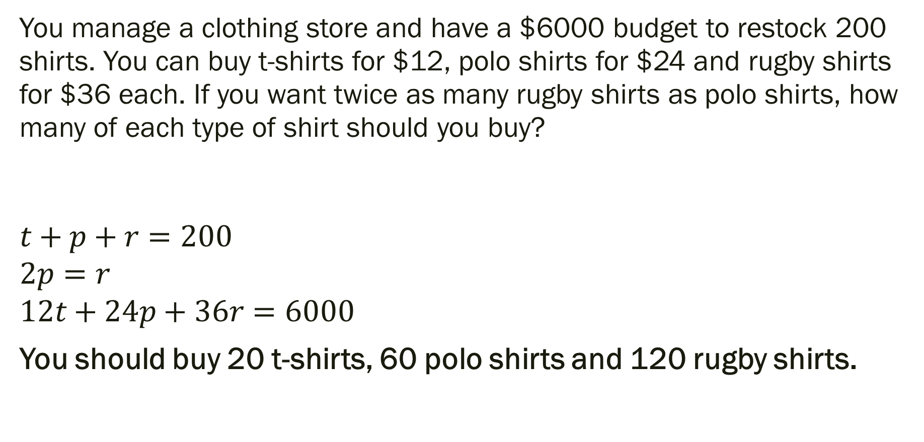
Write a system and solve.
You manage a clothing store and have a $6000 budget to restock 200 shirts. You can buy t-shirts for $12, polo shirts for $24 and rugby shirts for $36 each. If you want twice as many rugby shirts as polo shirts, how many of each type of shirt should you buy?
$$t+p+r=200$$
$$2p=r$$
$$12t+24p+36r=6000$$
You should buy 20 t-shirts, 60 polo shirts and 120 rugby shirts.

Slide 12
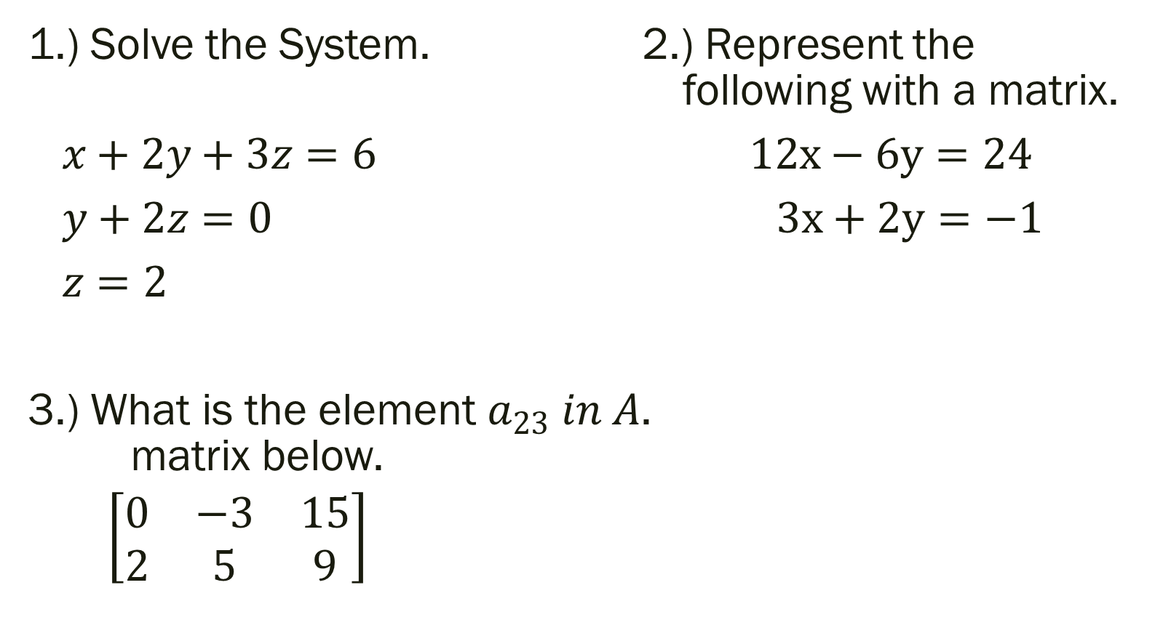
Unit 3 Quiz 2: Level 2
1.) Solve the System. 2.) Represent the following with a matrix.
$x+2y+3z=6 12x−6y=24$
$y+2z=0 3x+2y=−1$
$z=2$
3.) What is the element $a_{23} in A$. matrix below.
$\left[\begin{matrix}0 & −3 & 15 \\ 2 & 5 & 9\end{matrix}\right]$

Slide 13

Unit 3 Quiz 2: Level 3
Solve the following matrix.
4.) $\left[\begin{matrix}0 & −3 & 15 \\ 2 & 5 & 9\end{matrix}\right]$
5.) $2x+3y−2z=−1$
$x=−5y+9$
$$−5x+4z=4$$
Unit 3 Quiz 2: Level 4

Slide 14
For Next Time
New Material:
Page 171 #2, 21, 23
Mixed Review:
Page 173 #51, 54, 55, 56

